Slide 1
ASP.NET Web API
Created by Alex Bely,
Alex Karmaz

Slide 2
What is ASP.NET Web API
ASP.NET Web API is a framework for building HTTP services that can be accessed from any client including browsers and mobile devices. It is an ideal platform for building RESTful applications on the .NET Framework.
Syntaxically close to ASP.NET MVC
ApiController support was added to ASP.NET MVC 4 – Web API Basics
Web API support libraries were separated from MVC in ASP.NET MVC 5. It becomes possible to create independent Web API service
ASP.NET MVC 6 unites MVC, Web API and Web Pages

Slide 3
Client-side principal of work
Client makes HTTP-request to any resource
Client (synchronously or asynchronously) gets response with result code and XML or JSON data
Using REST client actions are limited with HTTP methods for resource handling: GET, POST, PUT, DELETE, PATCH, OPTIONS

Slide 4
Basic HTTP methods
GET – retrieving a representation of a resource
POST – creating a resource. Attempt of creating the same resource must cause an error
PUT – updating existing resource. Used only for previously created resources
DELETE – removing a resource

Slide 5
REST – Representational State Transfer
REST is a style of software architecture for distributed systems such as the WWW, where, virtually in all cases, the HTTP protocol is used.
Each resource is represented by a global id (URI in HTTP)
The resources are conceptually separate from the representations that are returned to the client (JSON/XML)

Slide 6
Server-side implementation
Functional is divided with controllers, that must comply with the requirements :
Name is finished with Controller
Parent class is ApiController
Method name must start with the HTTP-method prefix
Action methods based on the same HTTP-method must have different argument set and names
Overloading methods with the HTTP method names is allowed(Get, Post, …)

Slide 7
Request methods
Allowed
IEnumerable<Product> Get()
Product Get(int id)
IEnumerable<Product> Get(string name)
IEnumerable<Product> Get(int id, string name)
Not allowed
Product GetProduct (int id)
IEnumerable<Product> GetProduct (string name)

Slide 8
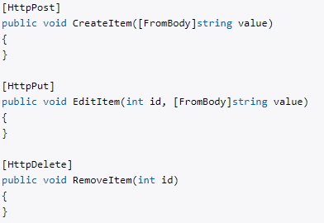
Method attribute
It is allowed to use any other names of action methods, but corresponding HTTP method must be clearly defined with the attribute

Slide 9
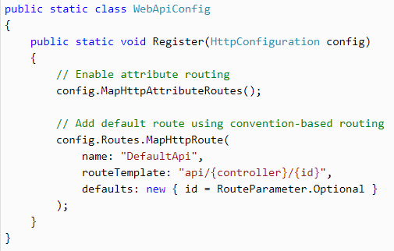
Routing
Route is defined, by default, as api/{controller}/{id} where action is defined by an HTTP method (in WebApiConfig Register method).

Slide 10
Request examples
HTTP Method | URI Path | Action
GET | /api/products | GetAllProducts
GET | /api/products/id | GetProductById
GET | /api/products/?category=category | GetProductsByCategory
POST | /api/products | PostProduct
PUT | /api/products/id | PutCategory
DELETE | /api/products/id | DeleteCategory

Slide 11
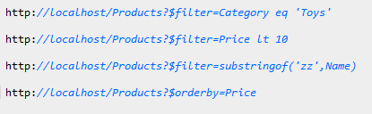
OData Protocol
The Open Data Protocol (OData) is a Web protocol for querying and updating data. OData provides a uniform way to structure data, query the data, and manipulate the data set through CRUD operations.

Slide 12
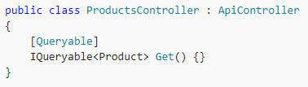
OData Protocol
Action returns IQueryable<T> and uses Queryable attribute
Available as Nuget package

Slide 13
Thank you

